Slide 1
Solids

Slide 2
Welcome to this lesson on solids! This Smart Lesson will teach you about solids in a little more detail. By the end of this lesson, you should be able to:
Recall that solids have a definite shape and volume.
Explain that particles in a solid have low energy and are connected by many bonds.
Demonstrate your knowledge of particle behaviour and the physical properties of a solid.

Slide 3
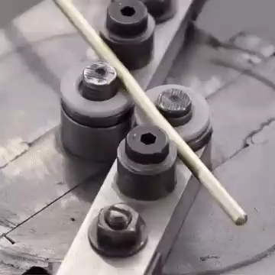
Solids have a definite shape.
A solid's shape will not change unless you apply an external force.
Some examples of external forces being applied are when you bend wire or cut a piece of wood in half. If left on their own, they would stay the same shape.

Slide 4
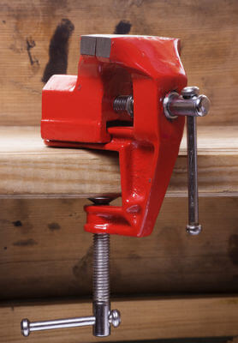
Solids also have a definite volume.
A solid will occupy the same amount of space even if you bend it or cut it in half.
Another way of saying this is that solids are incompressible: they cannot be compressed.

Slide 5

The incompressibility of solids can be seen in everyday life.
Have you ever tried to fit your stuff in a box that is way too small?
You cannot get your stuff to fit because you cannot compress the solid objects to make them smaller. They are incompressible.

Slide 6
Some solid objects appear to be compressible.
For example, the gif below showing a can being crushed. However, the inside of the can is not solid, it is full of air which is a gas. Gases are compressible, so as the can is crushed, the air will be pushed out of the can or be compressed inside the can.
The volume of the can itself has not changed, only the shape has changed from the force being applied.

Slide 7
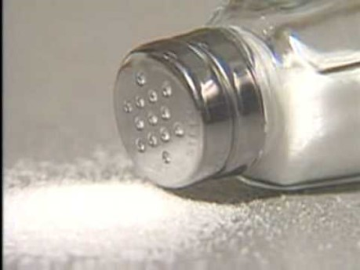
Watch this video (0:50) to find out more about the definite shape and volume of solids.

Slide 8
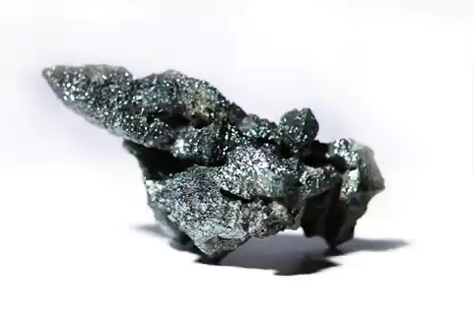
The particles in a solid behave in a particular way to give it a definite shape and volume.

Slide 9

The particles in a solid have low energy.
This means they do not have enough energy to overcome the attractions between them.
As a result there are many bonds between the particles of solids.

Slide 10

The bonds between particles mean solids have a definite volume.
The many bonds hold the particles very close together, leaving very little space between the particles.
As such, the particles cannot be moved any closer together even if you apply an external force.

Slide 11

The bonds between particles mean solids have a definite shape.
These bonds hold the particles in a fixed arrangement. They are stuck in place and cannot move around.
As a result the solid will not change its shape unless external forces are applied to it.

Slide 12
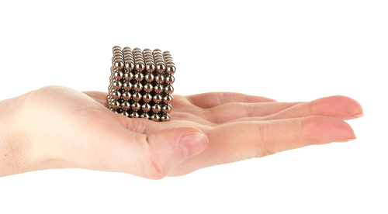
How can we visualise particle behaviour in a solid?
To help visualise how the fixed arrangement of particles gives solids a definite shape, look at the magnetic cube below. Imagine each magnetic sphere is a particle.
Strong magnetic attractions hold the spheres together. They cannot move and so are stuck in a fixed arrangement.

Slide 13
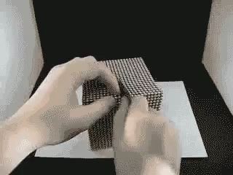
We can only change the arrangement of particles in our magnetic cube by applying an external force.
Even when the shape is changed, the total volume is still the same.

Slide 14

Particles in a solid vibrate while fixed in place.
Although the particles in a solid cannot move around freely, they continuously and rapidly vibrate, as shown below.

Slide 15
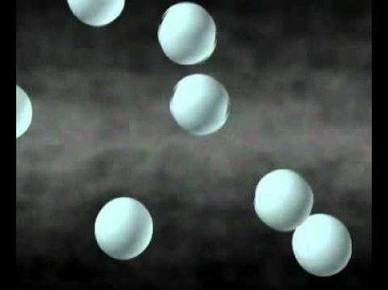
Watch this video (0:54) to review how the arrangement of particles in a solid give it a definite shape and volume.

